Slide 1

Capstone Project – Sports Analysis
Aniket Roy
Data Analytics

Slide 2
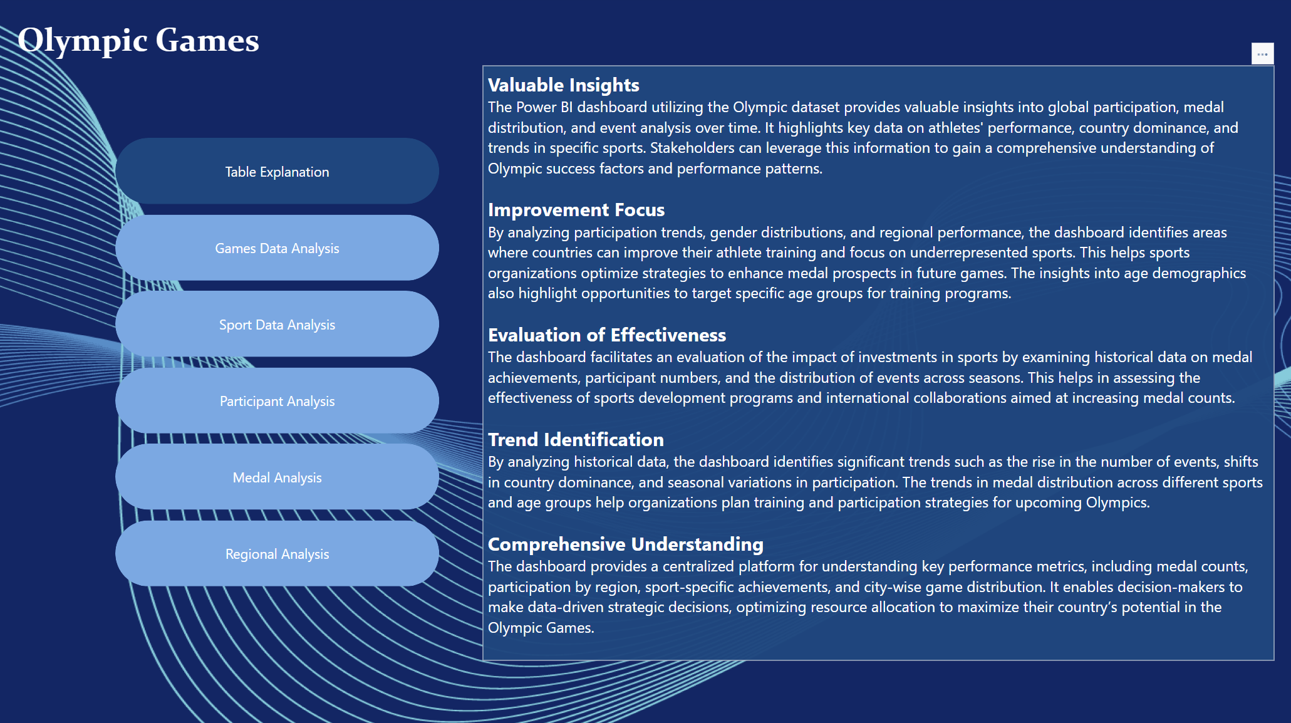

Slide 3
Objective: The objective of this project is to create a comprehensive Power BI dashboard utilizing Sports Dataset. The dashboard aims toanalyze historical Olympic Games data to uncover trends in participation, medal distribution, event dynamics, and regional representation
Analysis Scope: The analysis will focus on various aspects of the Olympic Games, It examines key patterns such as gender representation, regional participation growth, and the dominance of specific countries and sports, providing a comprehensive view of the Olympics’ history and areas for strategic improvement.
Goal: The primary goal of this Power BI dashboard is to offer a holistic view of the Olympic Games and the IOC operations. It’s aim is to deliver insights that optimize event planning, promote inclusivity, and guide stakeholders in enhancing global representation and competitiveness in future Olympic Games.

Slide 4
Insights & Recommendations: The Power BI dashboard analyzes key trends in participation, medal distributions, and event dynamics across multiple Olympic editions. It explores gender representation, regional participation growth, and the evolution of sports and events over time. Recommendations focus on promoting gender parity, supporting emerging regions, and diversifying sports offerings to meet global interest and encourage participation.
Report & Presentation: The final deliverable will include a detailed report outlining data sources, the EDA process, and the integration of SQL, Excel, and Power BI to extract actionable insights. The report will also describe how the findings inform strategic improvements in Olympic planning and representation. The presentation will focus on visualizing key trends, such as medal distributions, participation growth, and event dynamics, along with practical recommendations for stakeholders to implement in future Olympic Games.
The Power BI dashboard, combined with the report and presentation, will serve as a valuable tool for Olympic stakeholders. It will enable them to make data-driven decisions, optimize event planning, promote inclusivity, and enhance global participation, ultimately driving the success and evolution of the Olympic Games.landscape.

Slide 5
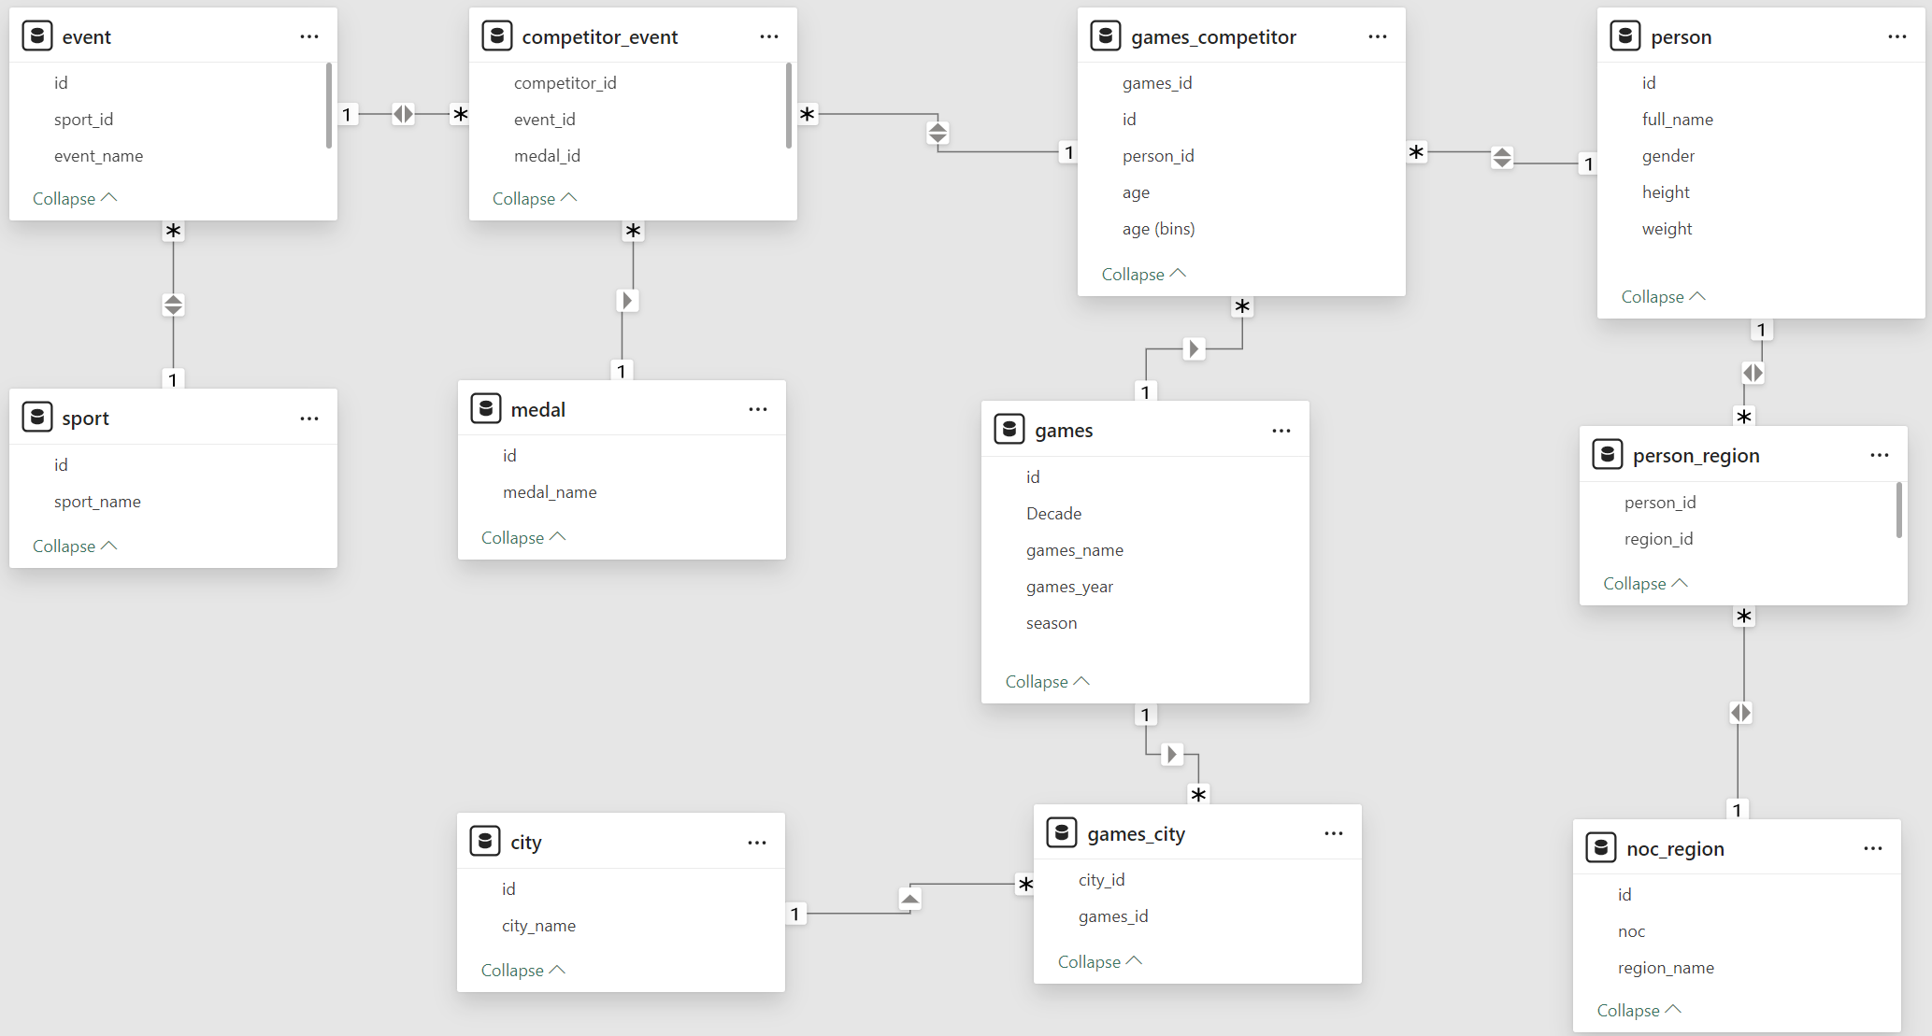
ER Diagram

Slide 6


Power BI Problem Statements

Slide 7
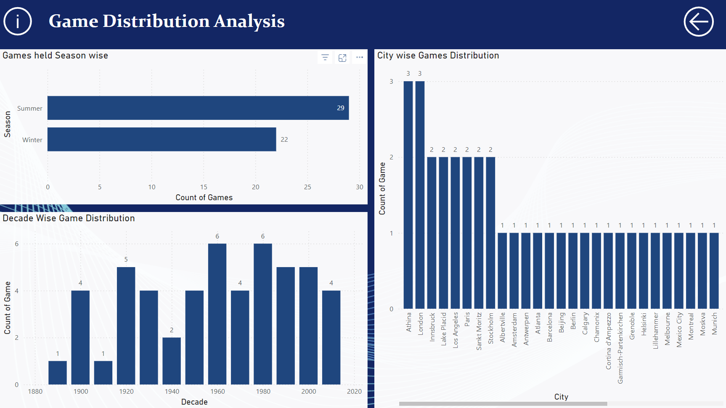

Slide 8
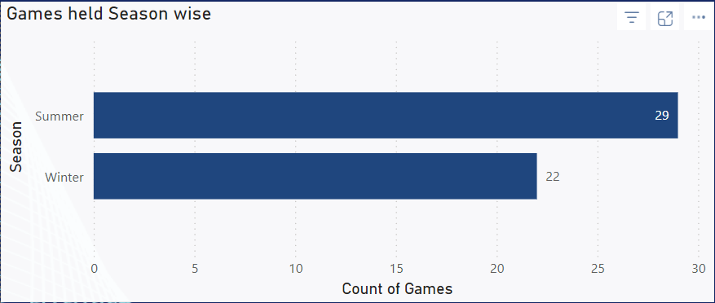
How many Olympic Games have been held in each season (Summer vs. Winter)?
The analysis shows that 29 Summer Olympic Games and 22 Winter Olympic Games have been held. This indicates the historical prominence and popularity of Summer Games, which include a broader range of sports and attract higher global participation compared to the more specialized Winter Games.

Slide 9
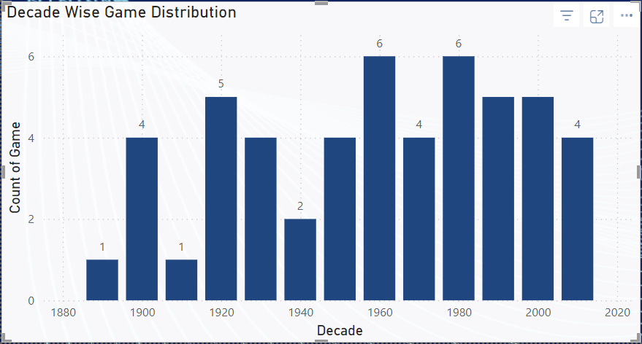
What is the distribution of games across different decades?
The distribution shows steady growth in the number of Olympic Games from the early 1900s, peaking with 6 Games per decade in the 1960s and 1980s. The decline during the 1940s reflects the impact of World War II, while consistent counts from the 2000s onward highlight the modern stability of the Olympics schedule.

Slide 10
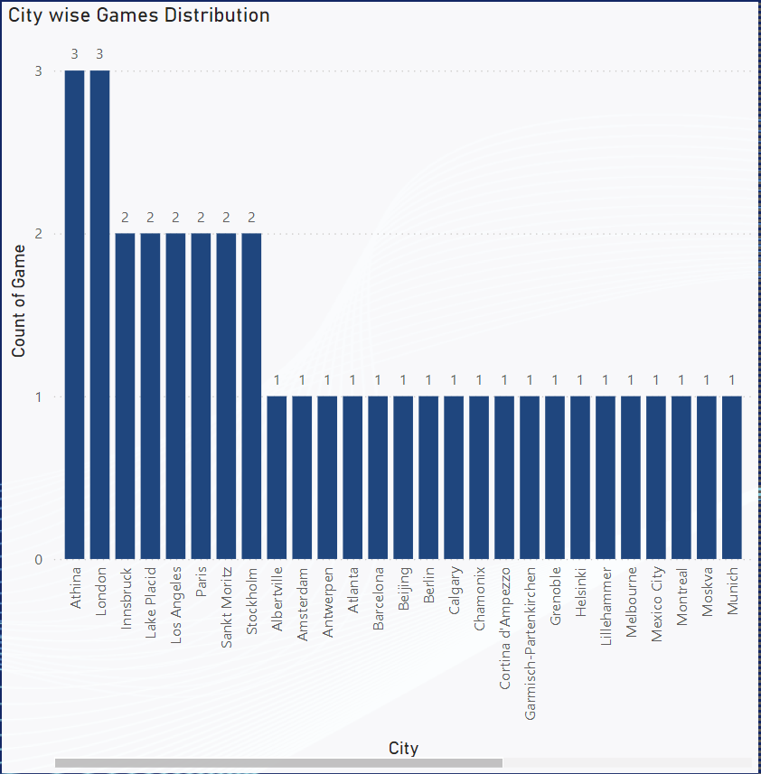
Which cities have hosted the most Olympic Games?
Athens, London, and Paris have each hosted the Olympics three times, making them the cities with the highest count. Several other cities, such as Los Angeles, Lake Placid, and Innsbruck, have hosted twice, showcasing a concentration of events in historically significant and well-equipped locations.

Slide 11
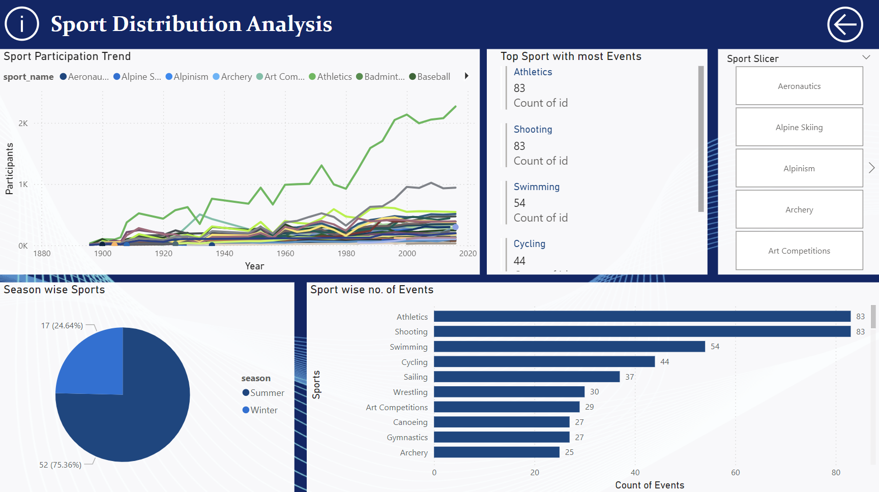

Slide 12
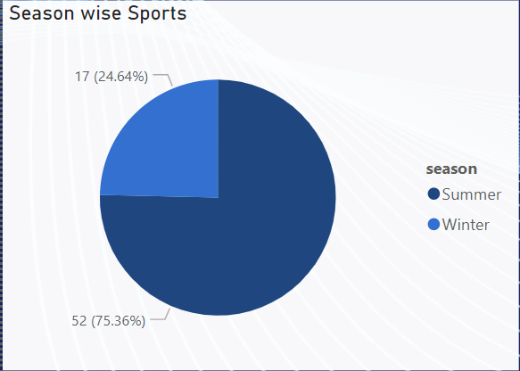
What is the distribution of sports between Summer and Winter Olympics?
The Summer Olympics dominate with 52 sports (75.36%), while the Winter Olympics feature 17 sports (24.64%). This highlights the greater diversity and global appeal of Summer Games, which encompass a wide range of disciplines compared to the more specialized nature of Winter sports.

Slide 13
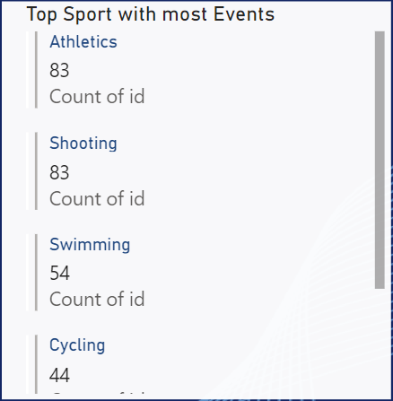
Which sports have the highest number of events in the Olympics?
Athletics and Shooting top the list with 83 events each, followed by Swimming with 54 events and Cycling with 44. These sports represent a significant portion of the Olympic program, reflecting their broad appeal and historical importance in the Games. Their diversity of events also highlights the inclusivity and competitive opportunities they provide for athletes worldwide.

Slide 14
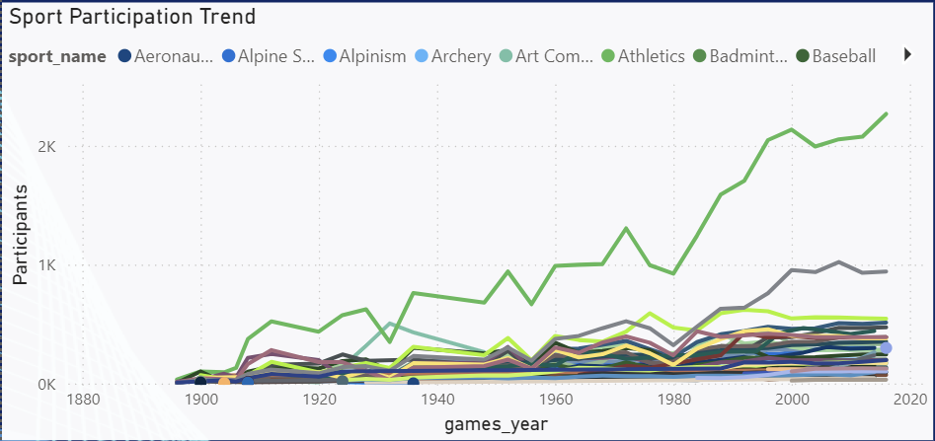
How has the participation in each sport evolved over time?
The data reveals a steady increase in participation across most sports, with Athletics showing the most significant growth, particularly after 1980. This trend reflects the expansion of the Olympic Games and the addition of new events over the years. Emerging sports like Badminton and Baseball show late but notable growth, indicating their rising popularity. These patterns highlight the evolving diversity and inclusivity of the Olympics, driven by global interest and broader regional representation.

Slide 15
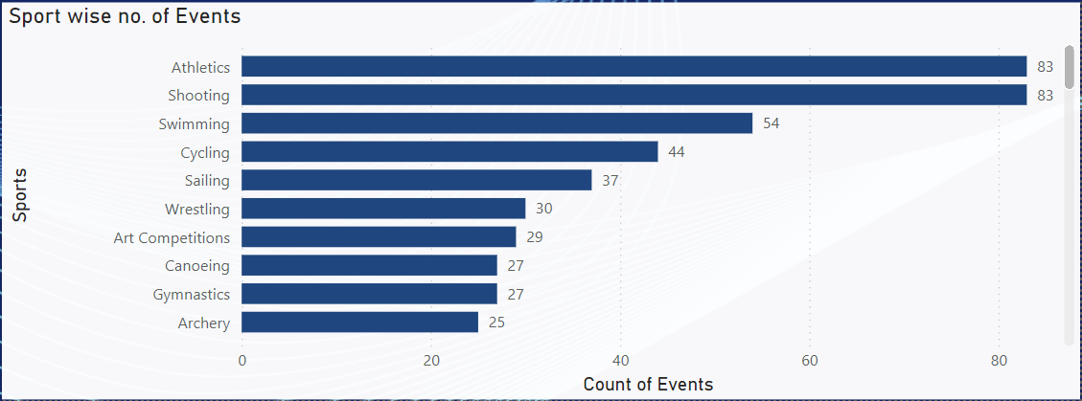
How many events are there in each sport?
Athletics and Shooting lead with 83 events each, followed by Swimming (54) and Cycling (44). Less-represented sports, such as Trampoline, Modern Pentathlon, and Synchronized Swimming, have fewer events, often focusing on niche athlete skill sets. This disparity highlights opportunities to expand the Olympic program by promoting these specialized sports, increasing their global visibility and participation.

Slide 16
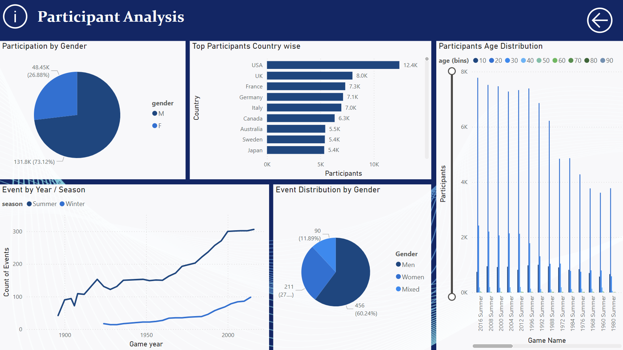

Slide 17
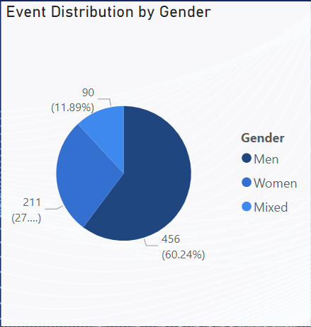
What is the distribution of events by gender (Men, Women, Mixed)?
The majority of events (60.24%) are for men, followed by women’s events (27.87%) and mixed-gender events (11.89%). While men’s events dominate, the steady increase in women’s and mixed-gender events reflects the Olympic Games’ efforts to promote inclusivity and gender balance over time.

Slide 18
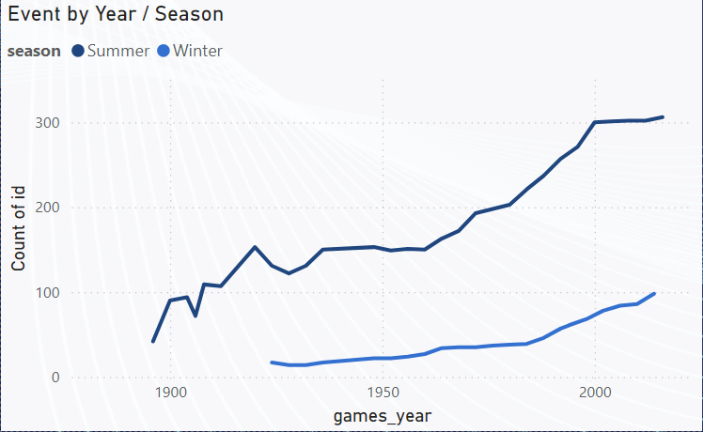
How has the number of events changed over time?
The number of events has steadily increased over time for both Summer and Winter Olympics. Summer events saw rapid growth post-1950, driven by the addition of diverse sports and categories. Winter events have expanded more slowly, partly due to fewer countries having snowy or cold regions to support widespread participation, limiting growth compared to the Summer Games.

Slide 19
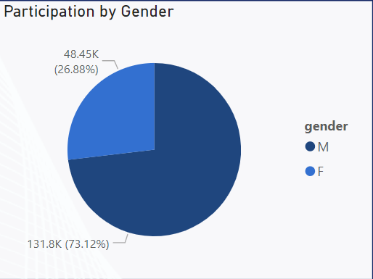
What is the distribution of participants by gender?
Male participants make up 73.12% of the total, while female participants account for 26.88%. This highlights a historical disparity in gender representation, though the steady rise in female participation over recent years reflects ongoing efforts to achieve greater gender balance in the Olympics.

Slide 20
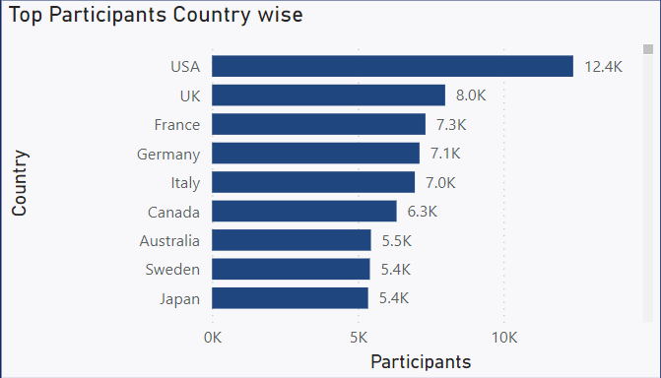
Which countries have the highest number of participants in the Olympics?
The USA leads with 12.4K participants, followed by the UK (8K) and France (7.3K). Other countries like Germany, Italy, and Canada also show strong representation. This dominance reflects the resources and infrastructure available in these countries to support Olympic training. Additionally, the consistent participation from these nations highlights their deep-rooted Olympic traditions and strong focus on athlete development across diverse sports.

Slide 21
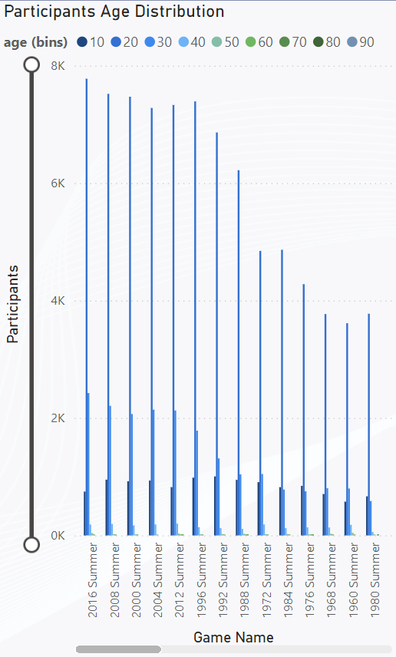
How does the age distribution of participants vary across different games?
The age distribution shows that most participants fall within the 20–30 age range, which consistently represents the peak athletic performance period across games. There is also notable participation in the 30–40 range, reflecting seasoned athletes in endurance or technique-based sports. While younger athletes (under 20) and older participants (40+) are less common, their presence highlights the inclusivity of certain disciplines. This distribution has remained consistent across games, showcasing the broad appeal of the Olympics across age groups.

Slide 22
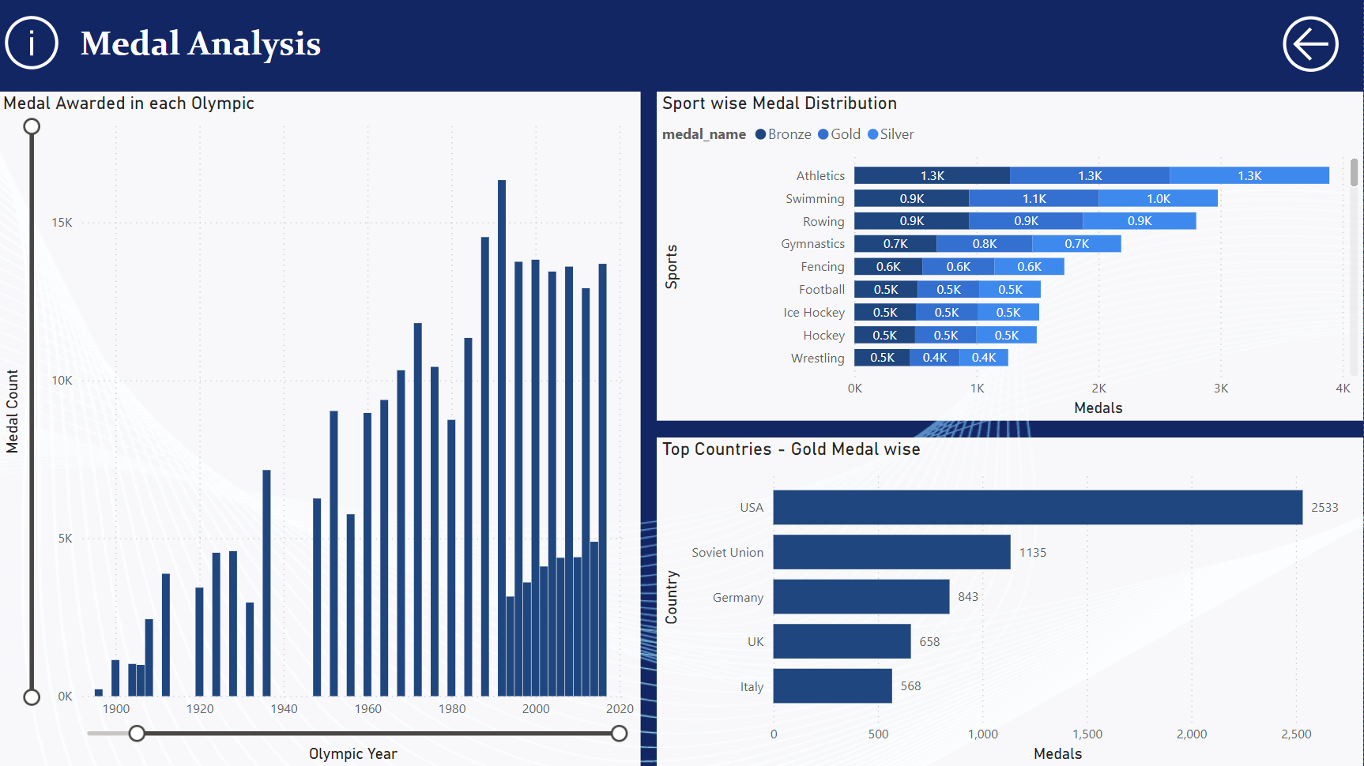

Slide 23
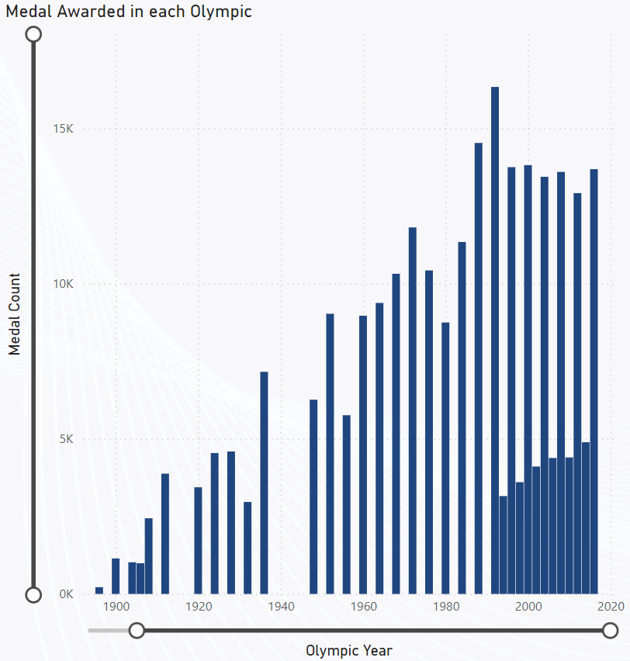
How many medals have been awarded in each Olympics?
The number of medals awarded has grown significantly over time, with recent Olympics consistently awarding over 15,000 medals due to the addition of new sports and events. The sharp decline in medals around the 1940s reflects the impact of global conflicts on the Games, Notably World War II. This overall growth trend underscores the increasing inclusivity and diversity of the Olympics.

Slide 24
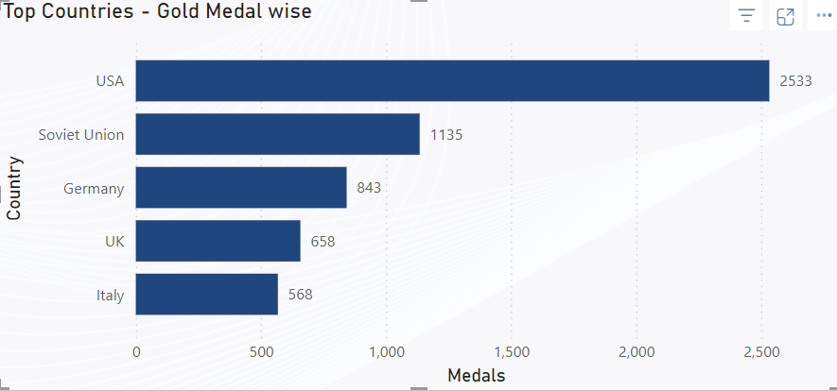
Which countries have the highest number of gold medals?
The USA leads significantly with 2,533 gold medals, followed by the Soviet Union with 1,135 and Germany with 843. Other top-performing countries include the UK (658) and Italy (568). This dominance reflects the strong sports infrastructure and training systems in these nations, which have consistently produced world-class athletes.

Slide 25
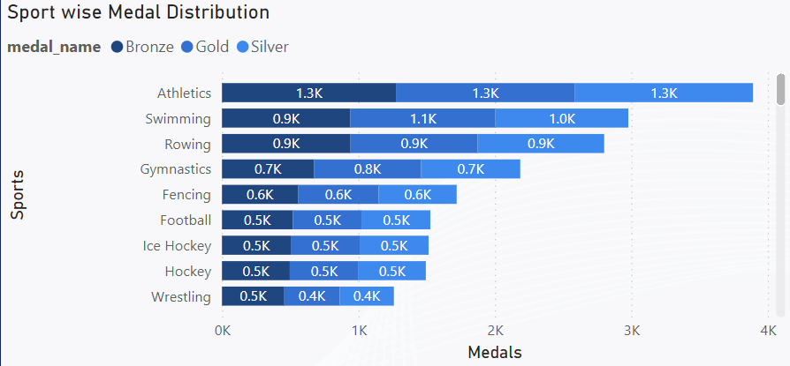
How does the medal distribution vary across different sports?
Athletics leads in medal distribution, with 1.3K medals in each category (gold, silver, and bronze). Swimming follows closely with 1.1K golds and 1.0K each in silver and bronze. Other sports like Rowing, Gymnastics, and Fencing also contribute significantly to the total medal count. This distribution reflects the broad range of events within these sports, attracting a high number of participants and offering diverse competitive opportunities.

Slide 26
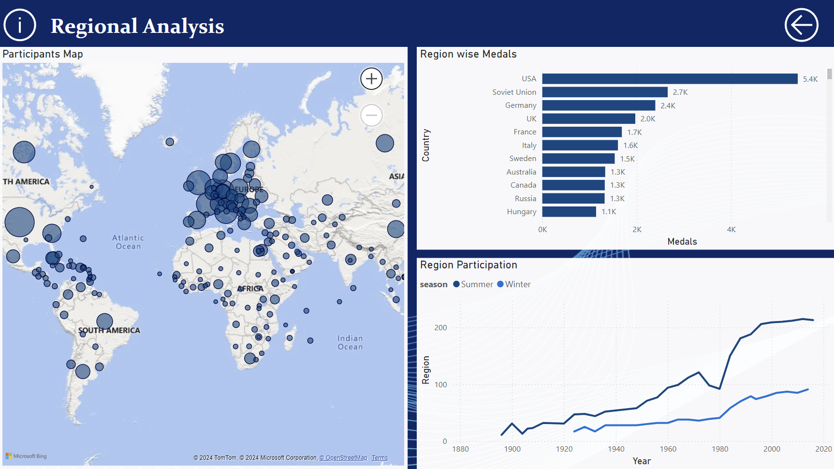

Slide 27
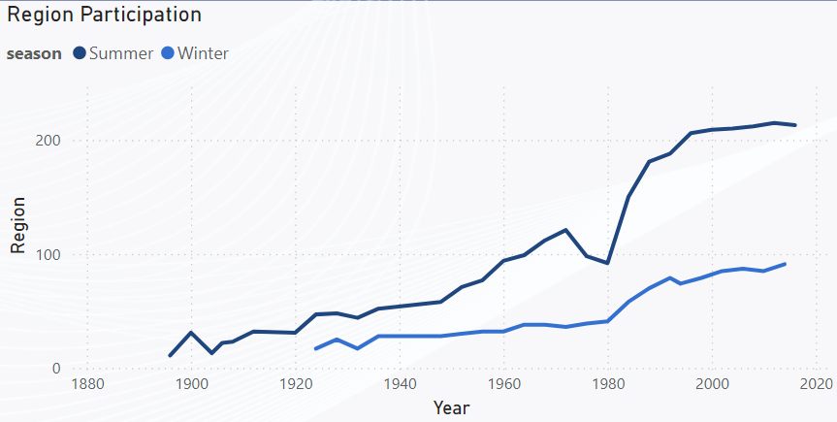
How many regions or NOCs participate in each Olympic Games?
Participation by regions or National Olympic Committees (NOCs) has grown steadily over time, with over 200 NOCs participating in recent Summer Olympics. Winter Olympics show slower growth due to climatic and geographical limitations, with around 100 participating regions in recent years. This trend reflects the increasing inclusivity and global reach of the Olympic Games.

Slide 28
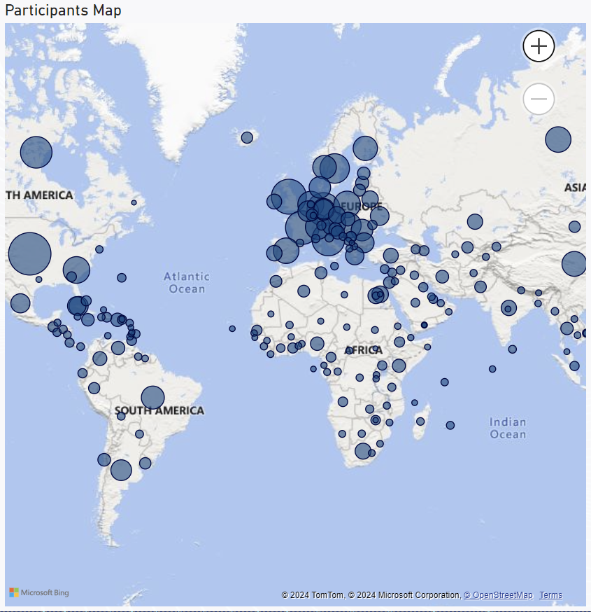
Which regions have the highest number of participants in the Olympics?
Countries with the highest overall participation include the United States (approx. 12,392 participants), the United Kingdom (approx. 7,999 participants), and France (approx. 7,323 participants). These numbers reflect their historical dominance in the Olympic Games. The growing inclusion of regions from Africa and South America in recent years highlights the increasing diversity and global reach of the Olympics.

Slide 29
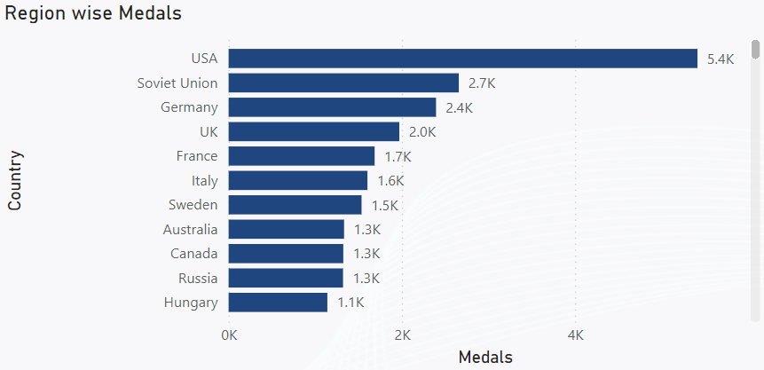
What is the distribution of medals among different regions?
The distribution of medals among regions highlights the dominance of certain nations in Olympic history. The United States leads significantly with 5,414 medals, followed by the Soviet Union with 2,658 medals, and Germany with 2,395 medals. Other top-performing regions include the United Kingdom (1,971 medals) and France (1,686 medals).These figures emphasize the historical competitiveness of these regions, reflecting their strong athletic traditions and investments in Olympic participation.

Slide 30
EDA Problem Statements

Slide 31
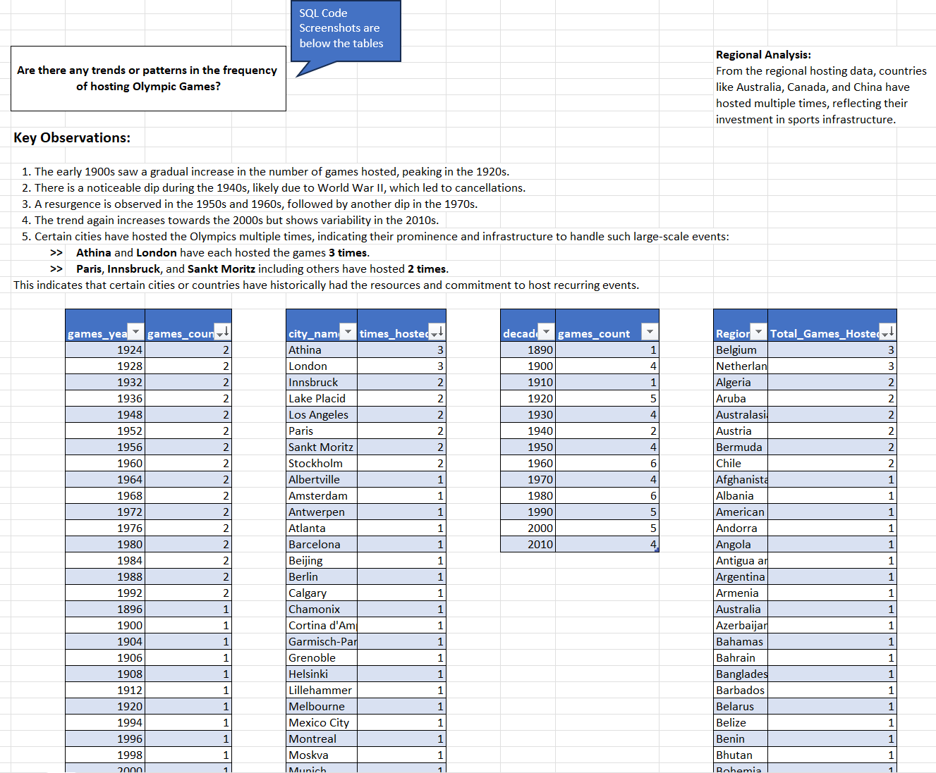
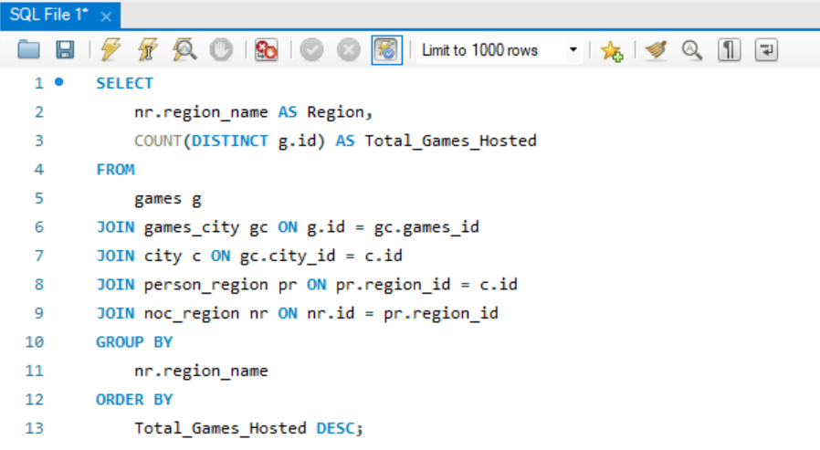
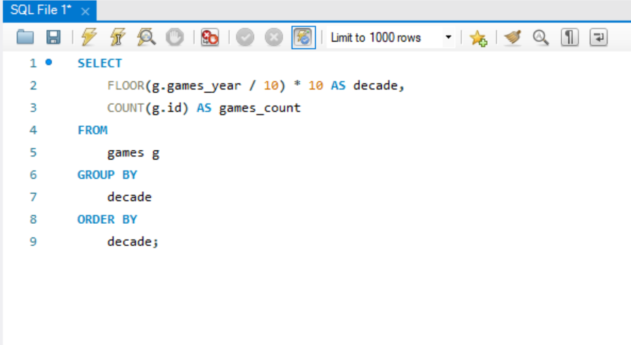
Conclusion:
Hosting trends reveal regional patterns:
Europe dominates with the highest hosting count, reflecting its early involvement and strong sports infrastructure.
Cities like Athens, London, and Paris have hosted multiple times, showcasing their historic significance in the Olympics.
The 21st century shows a push for regional diversity, with hosts like Beijing and Rio signaling increased inclusivity.

Slide 32
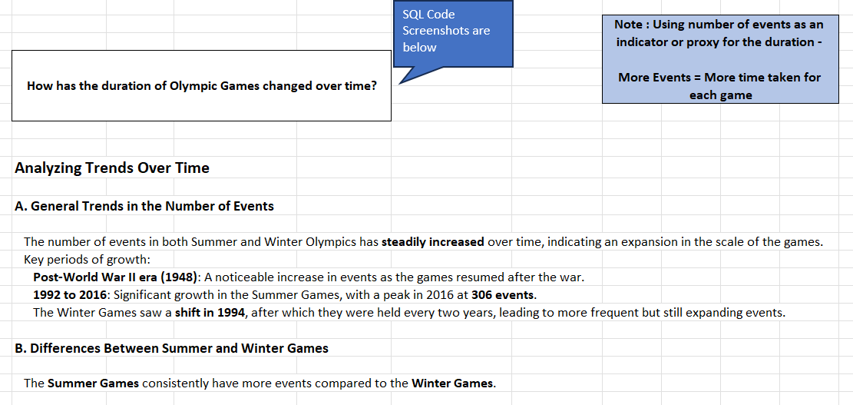
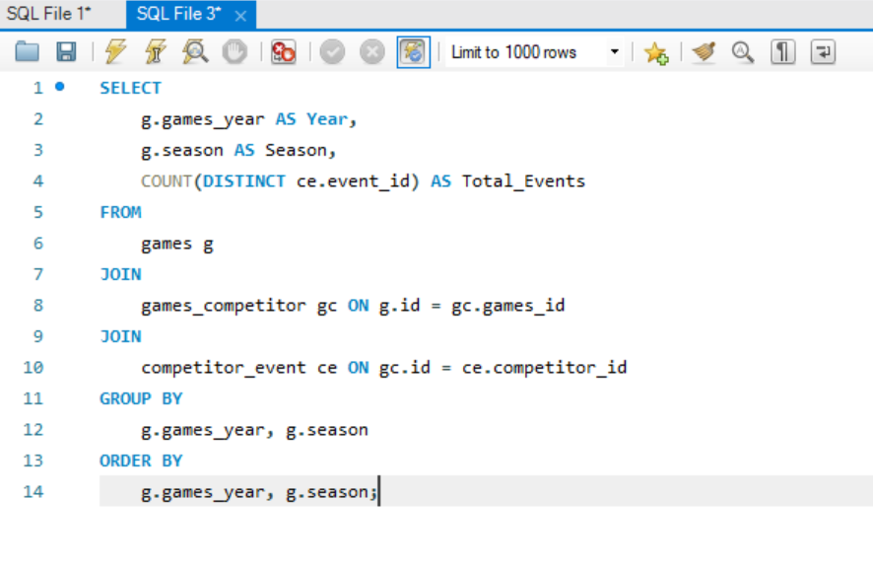
Conclusion:
The duration of the Olympic Games, measured by the number of events, has steadily increased over time:
Post-WWII (1948): A notable surge in both Summer and Winter Games.
1994 Shift: Winter Games moved to a new cycle, leading to more frequent hosting.
1992–2016: Major growth in Summer Games events due to global participation and new sports inclusion.

Slide 33
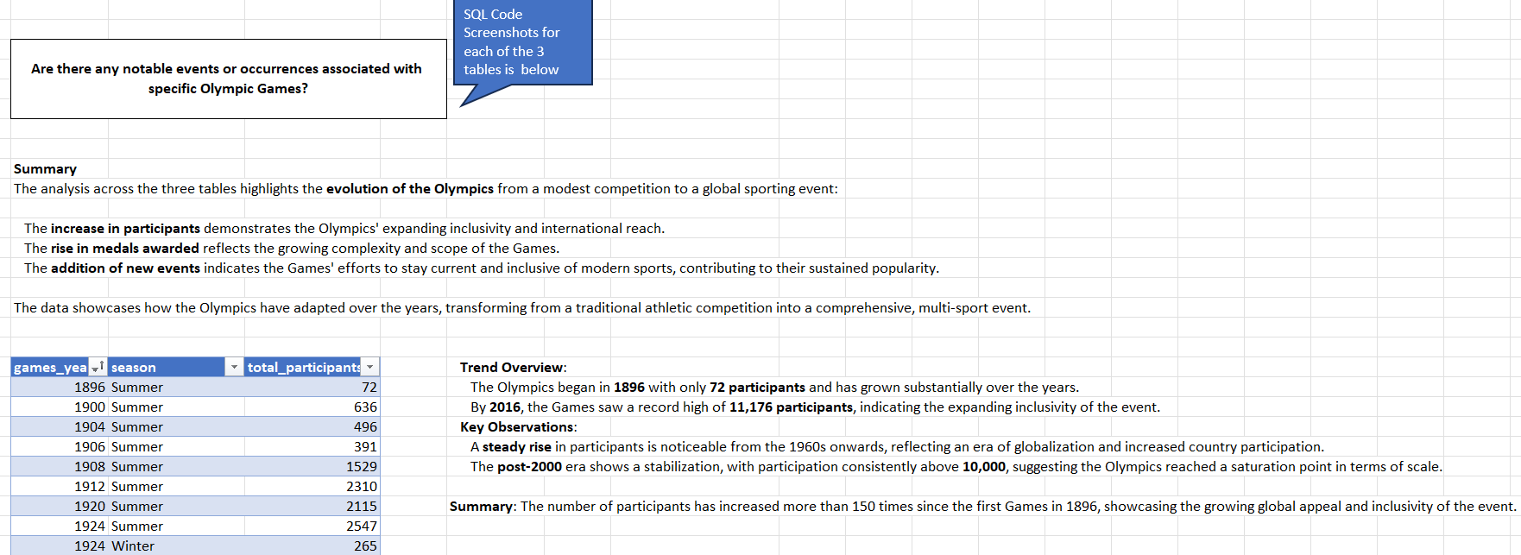
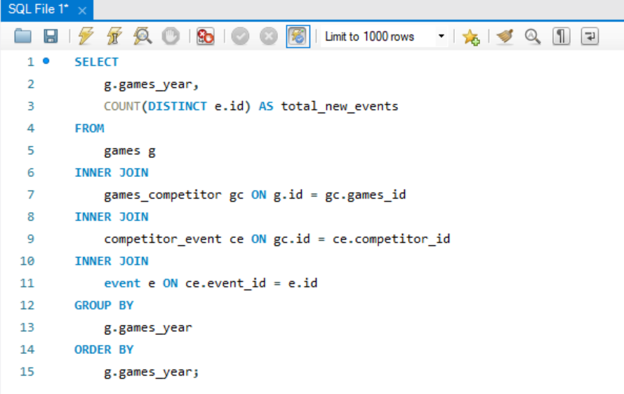
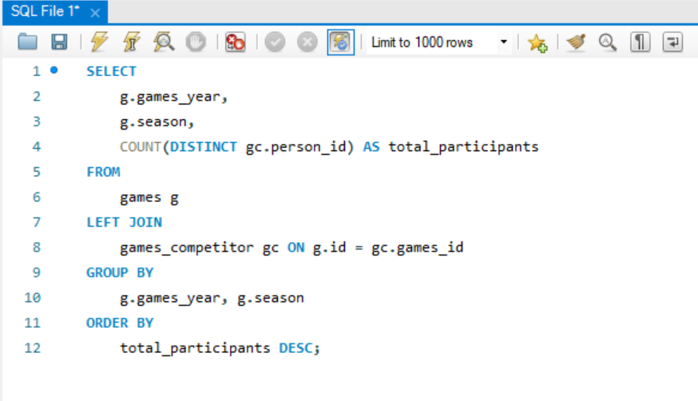
Conclusion:
The Olympics have seen several notable occurrences:
1896: The first modern Olympics hosted 72 participants, mainly European.
World Wars: Interruptions in 1916, 1940, and 1944 due to global conflicts.
Post-war era: Rapid global expansion with diverse sports and participants.
The Olympics' evolution reflects resilience and adaptability, responding to historical events while embracing inclusivity and global representation.

Slide 34
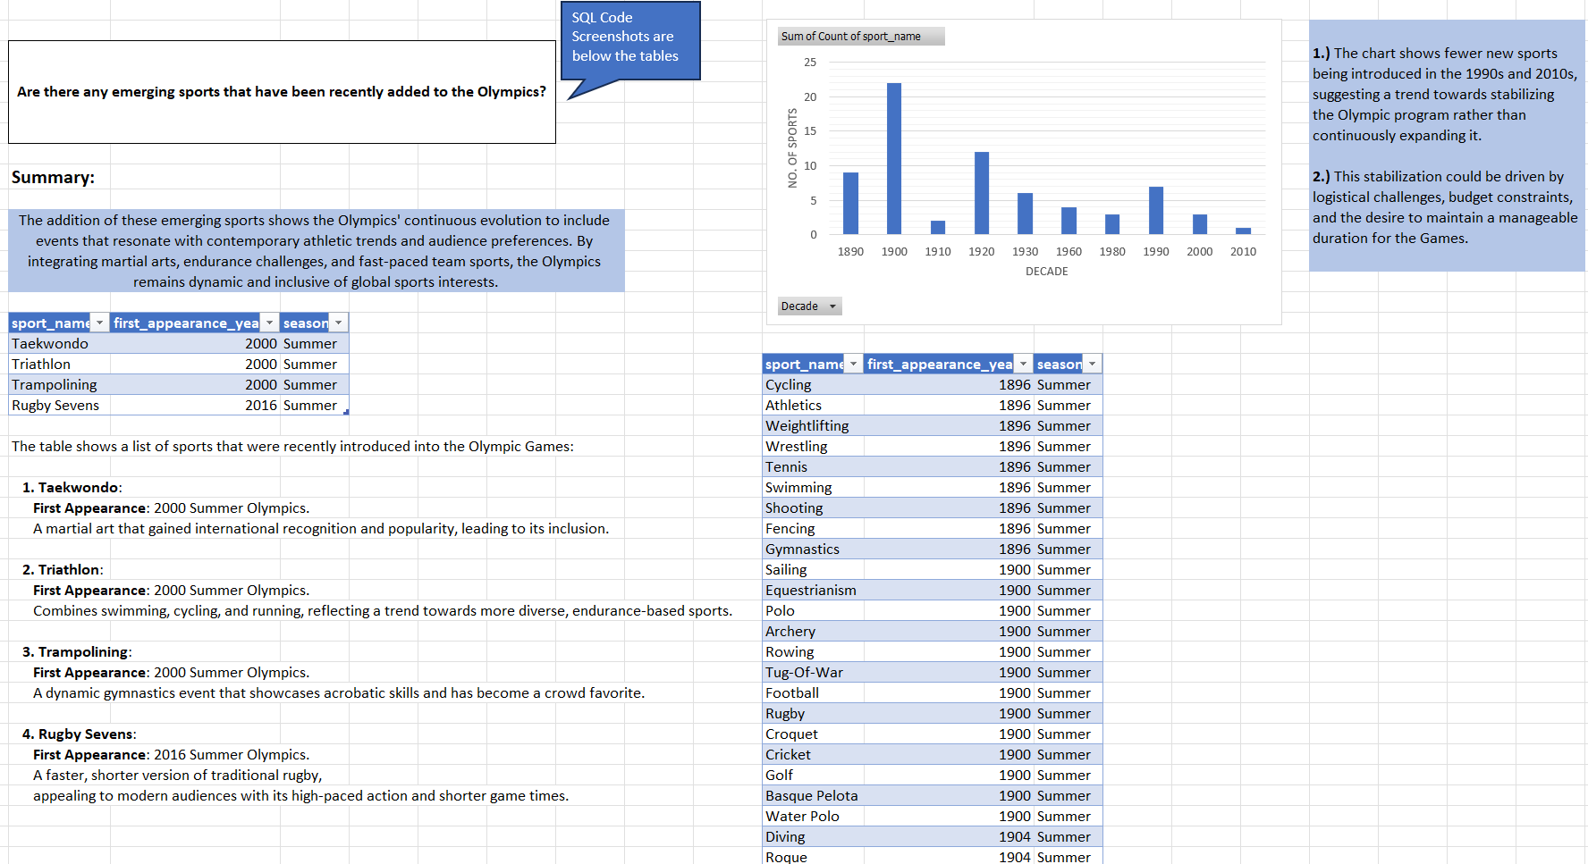
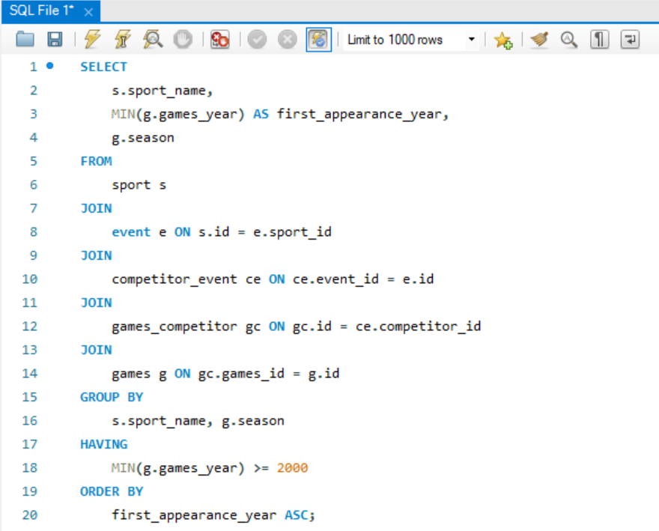

Slide 35
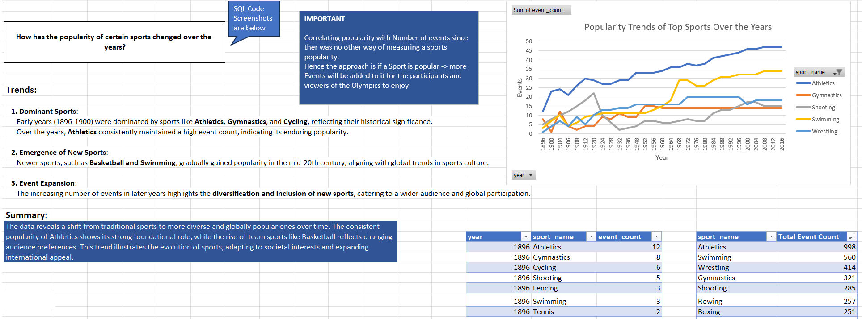
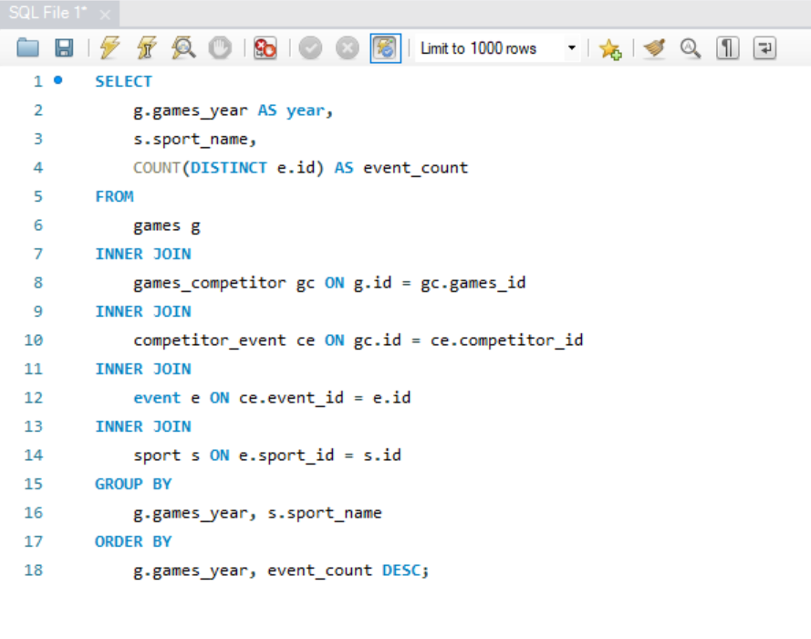
Conclusion:
The popularity of sports at the Olympics has evolved significantly:
Early Olympics: Athletics, Gymnastics, and Swimming dominated.
Later Years: Introduction of sports like Basketball and Badminton reflected shifting trends.
Event Growth: Popular sports like Swimming and Athletics saw expanded events, showcasing increasing global interest.

Slide 36
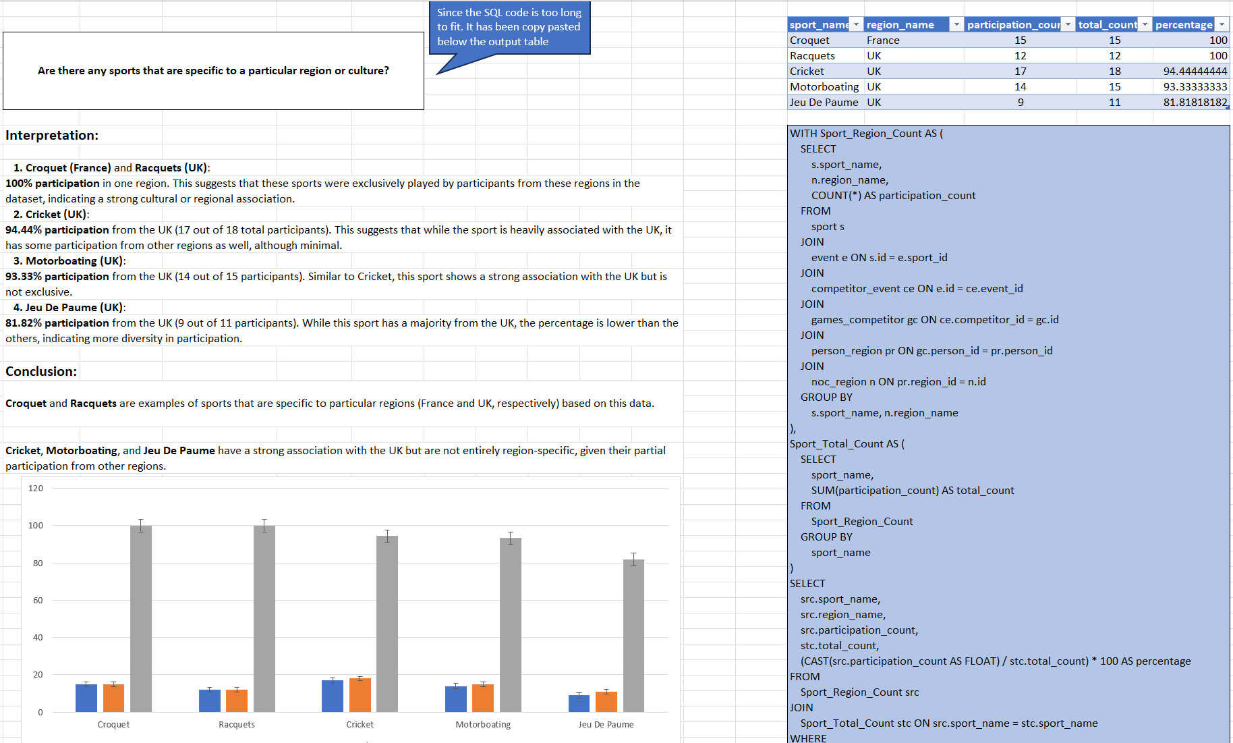
Conclusion:
Certain sports are culturally or regionally specific:
Croquet (France) and Racquets (UK): 100% participation localized.
Cricket, Motorboating, and Jeu De Paume have over 90% participation from the UK, reflecting their cultural origins.
These trends highlight how regional traditions and history influence Olympic sports.

Slide 37
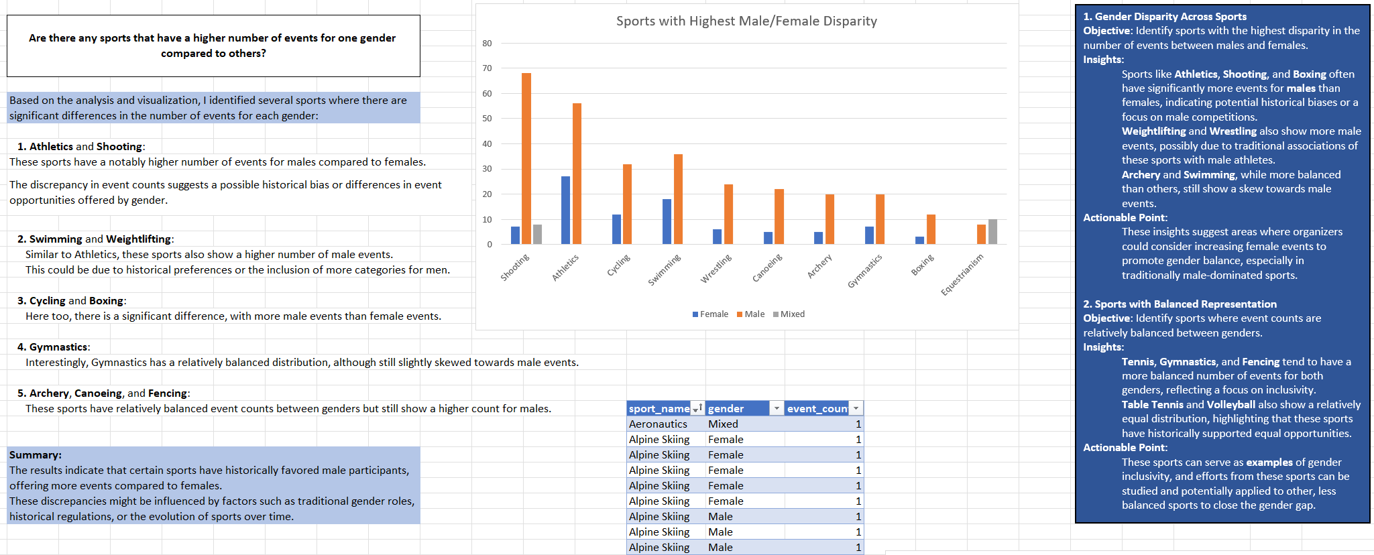
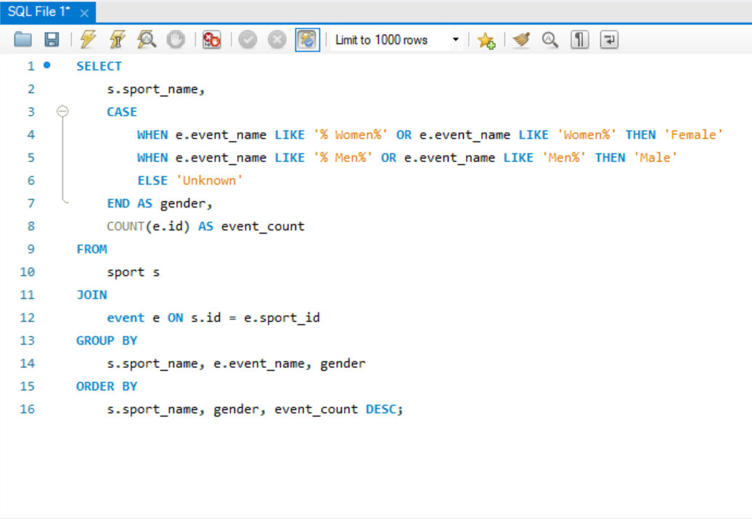

Slide 38
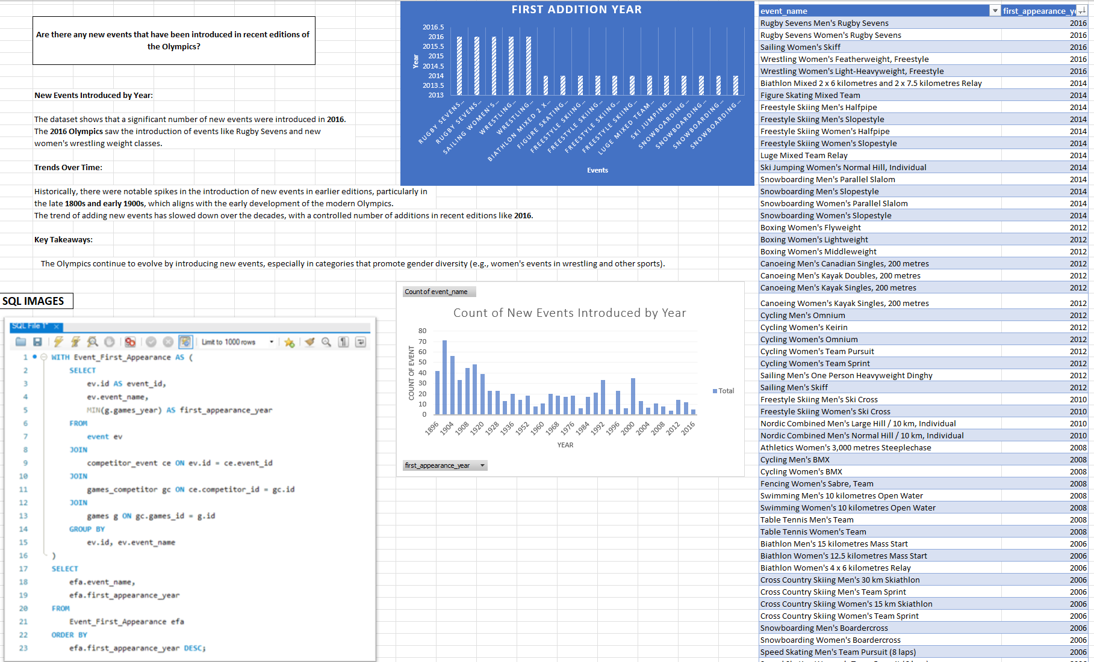

Slide 39
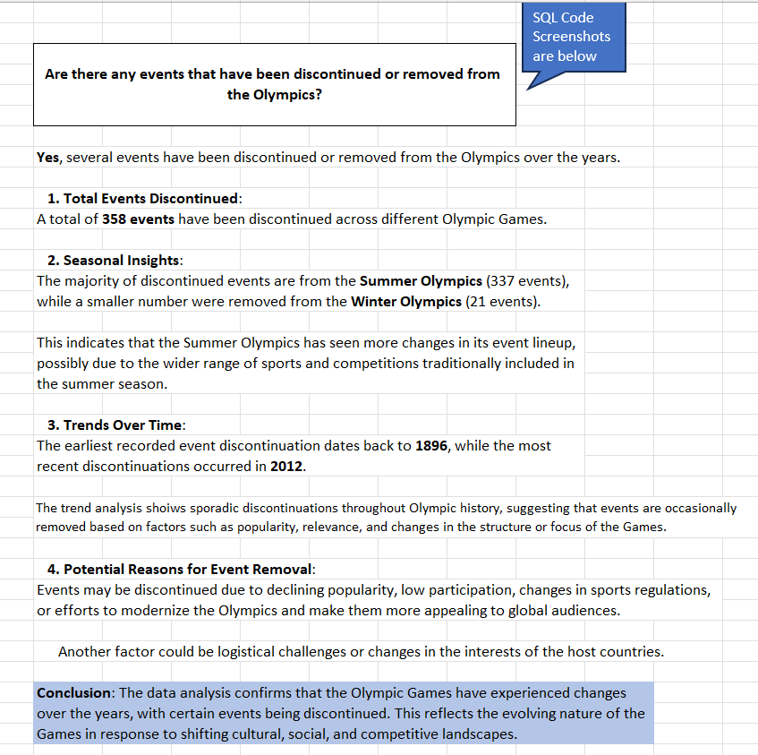
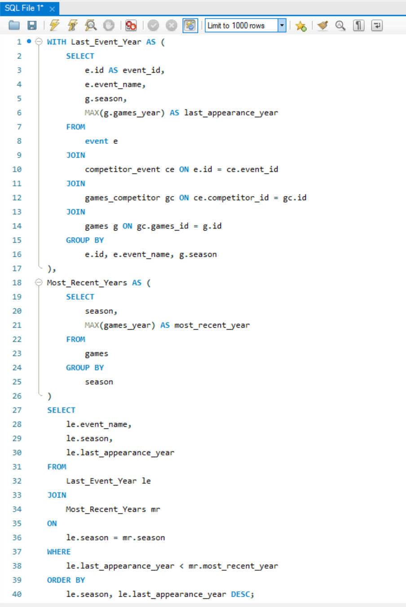
Conclusion:
Several events have been discontinued from the Olympics: Notable examples include: >Softball (2008).
>Cycling Men's Individual Pursuit (2008).
>Sailing Women's Three-Person Keelboat (2012). These changes reflect the evolving preferences and logistical adjustments of the Olympics.

Slide 40
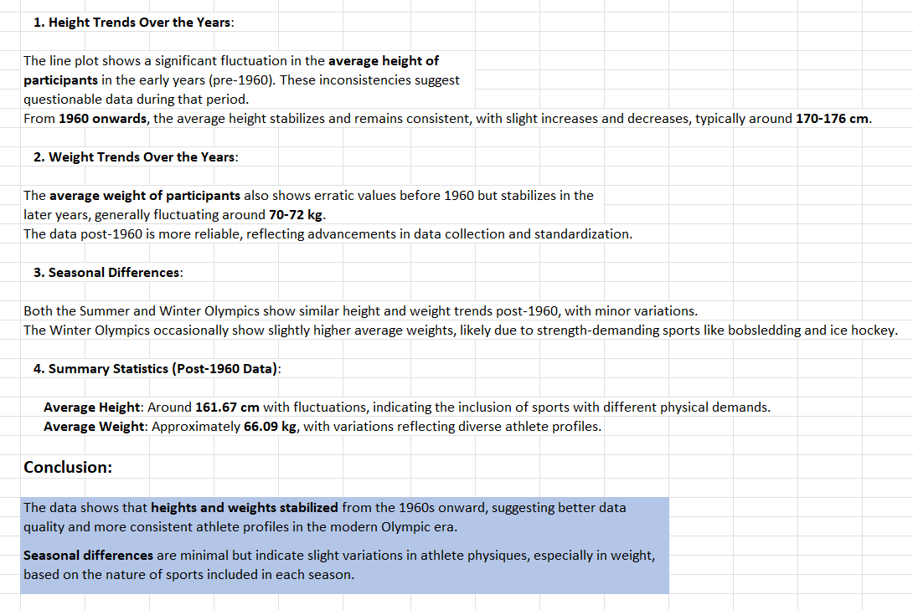
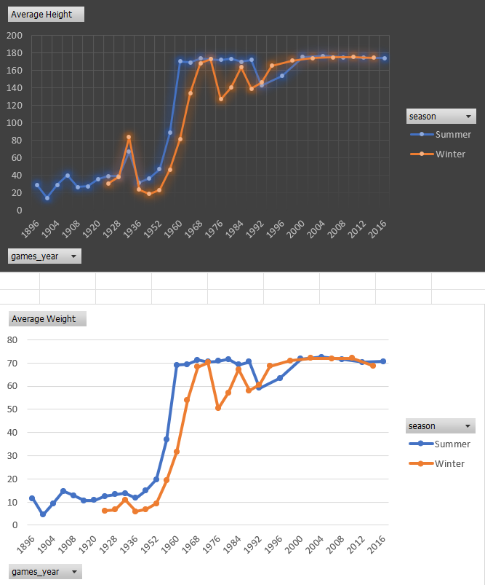
Question: Are there any notable trends in the height and weight of participants over time?

Slide 41
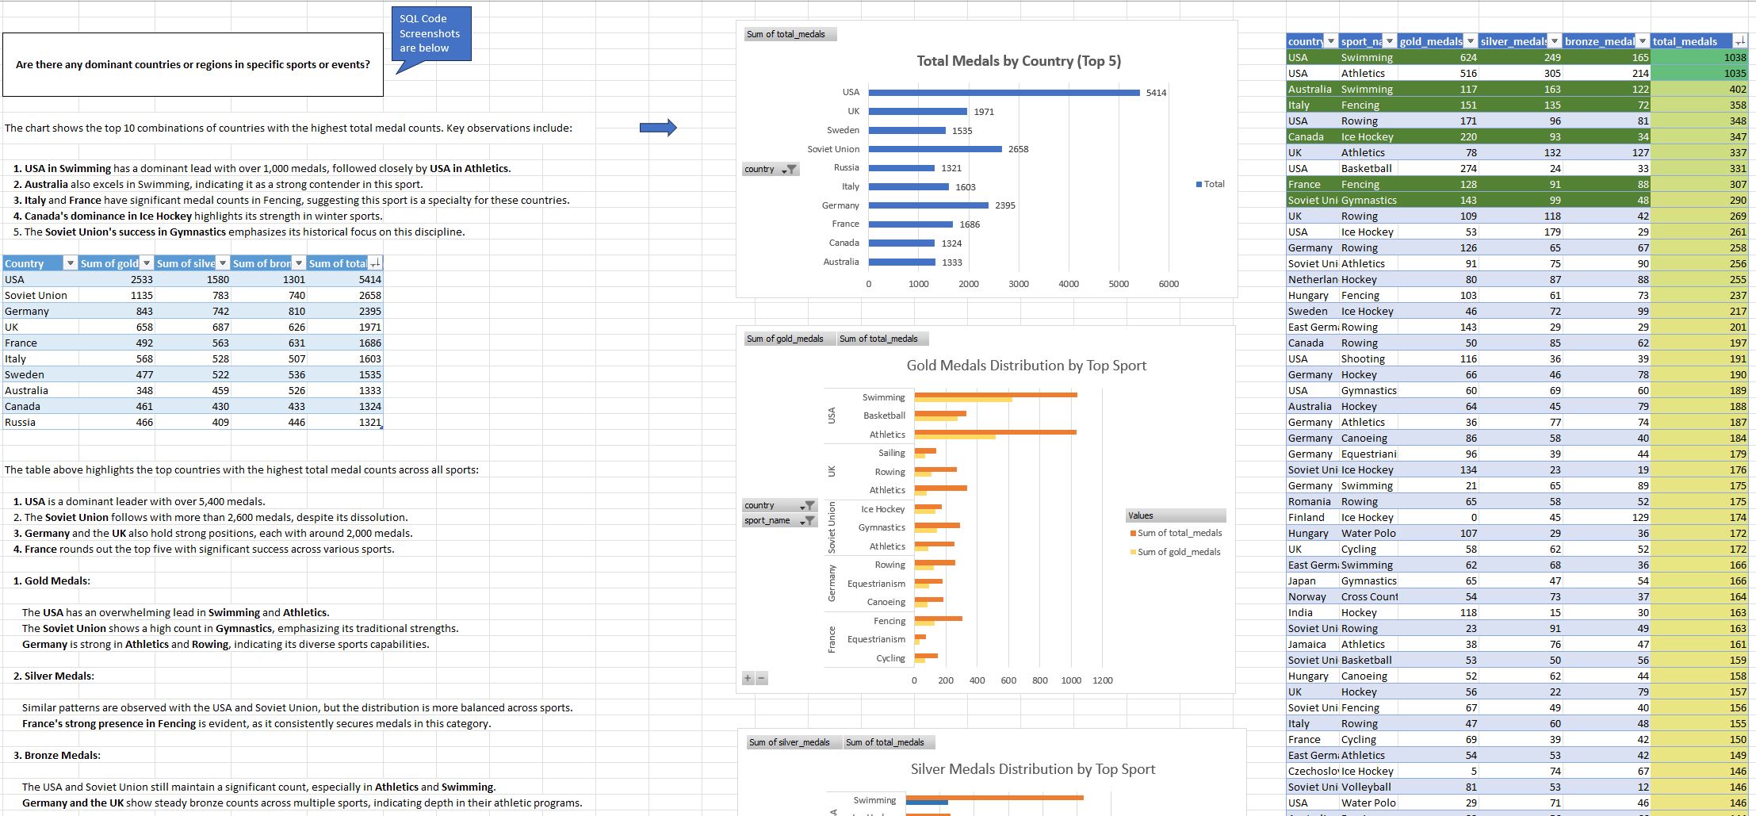
Summary: The analysis reveals that certain countries are dominant in specific sports:
The USA is overwhelmingly dominant in Swimming and Athletics, securing the highest number of total medals in these events. This highlights their historical strength and consistent performance in these categories.
The Soviet Union (including its historical records) excels in Gymnastics and Wrestling, showcasing its focus on skill-intensive sports.
Germany has a strong presence in Rowing and Athletics, indicating its strategic investment in endurance-based sports.
France and Italy dominate in Fencing, reflecting a cultural and historical tradition in this sport.
Canada leads in Ice Hockey, confirming its dominance in winter sports, especially team events. Overall, this highlights that specific countries have leveraged their strengths to dominate particular sports, reflecting strategic focus areas, historical expertise, and national interests in these events.

Slide 42
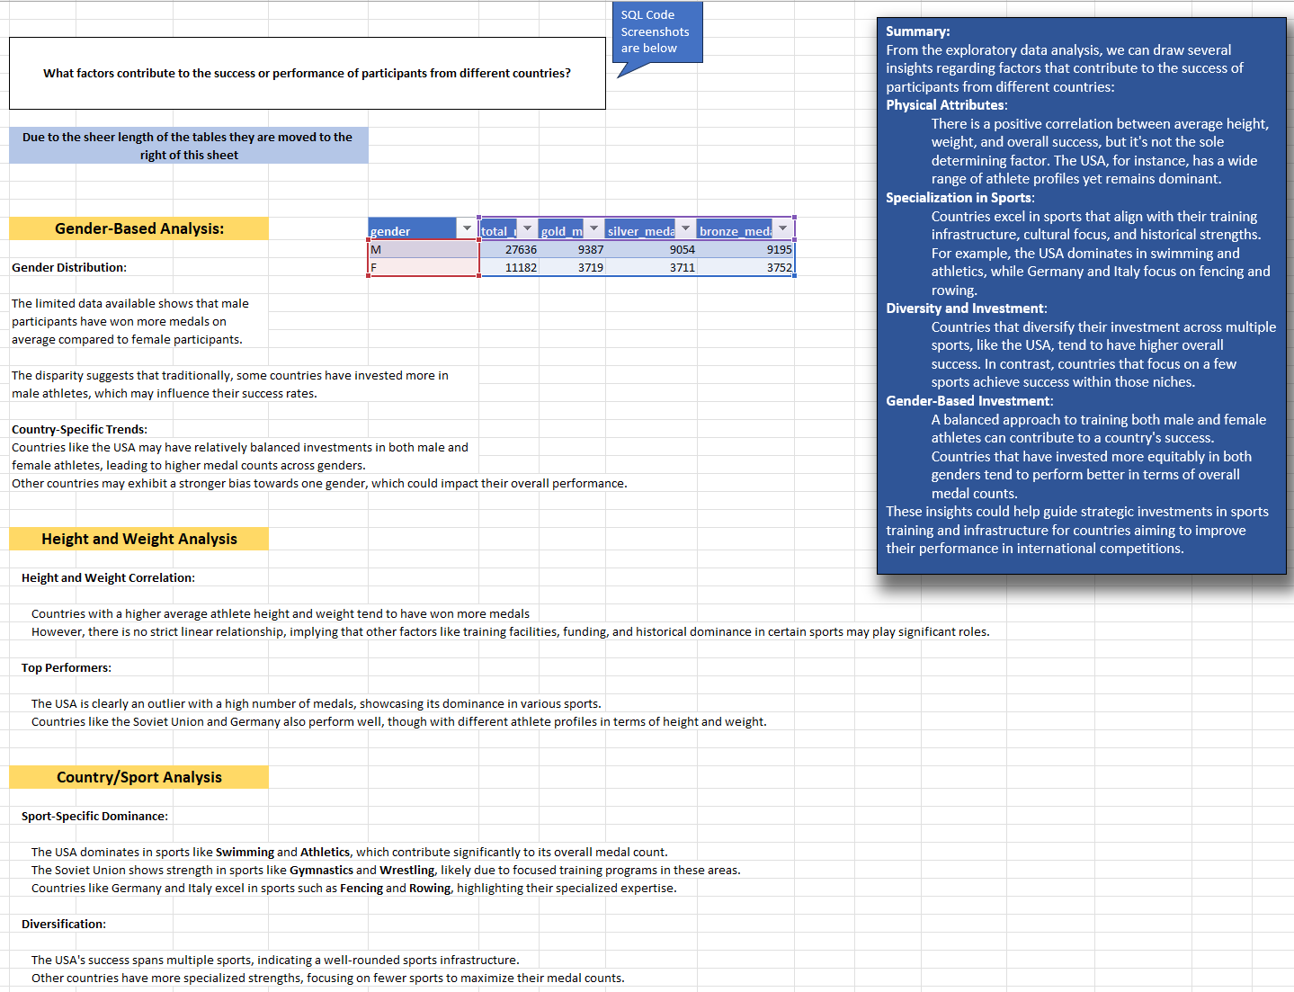

Slide 43
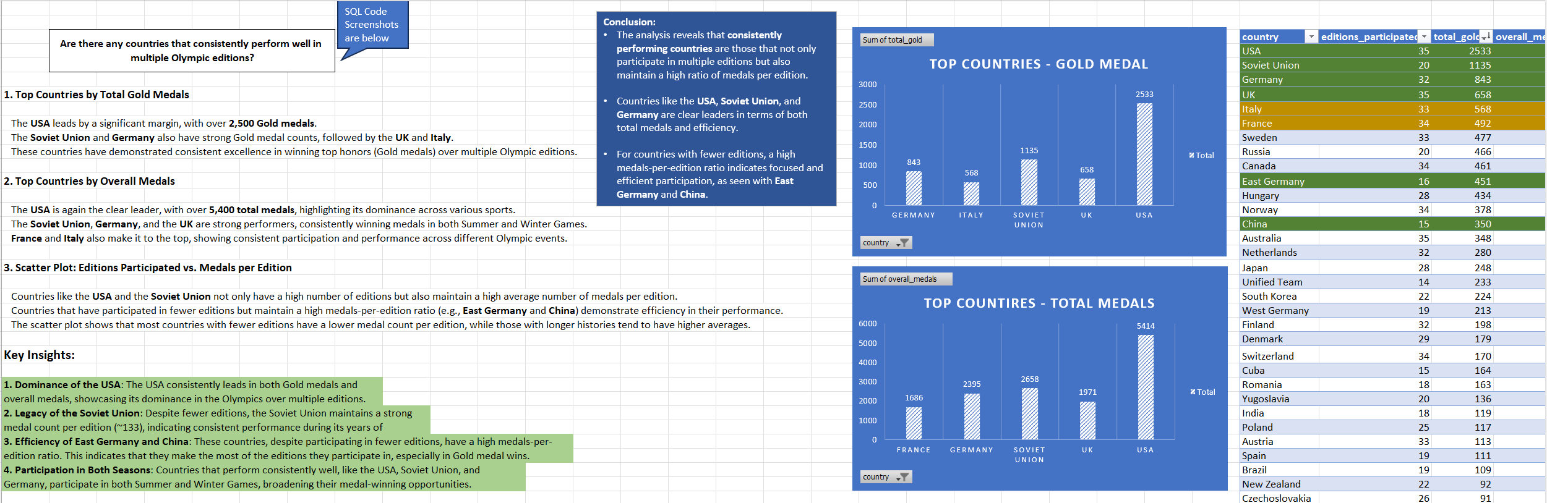
Conclusion: Several countries have consistently performed well in multiple Olympic editions: USA: Dominates with 5,414 total medals, 2,533 gold medals, and participation in 35 editions. Soviet Union and Germany: Notable performances with 2,658 and 2,395 total medals, respectively. UK: Consistently strong, with 1,971 medals across 35 editions. These results highlight the historical dominance and resilience of these nations in global sports.

Slide 44
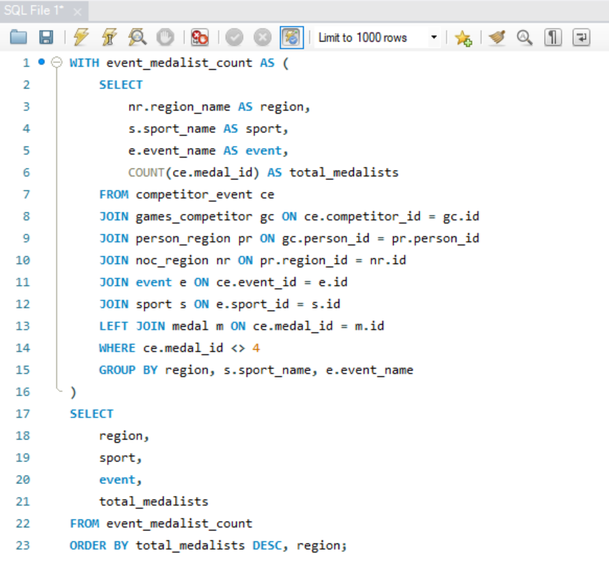
Question: Are there any sports or events that have a higher number of medalists from a specific region?
Key Findings:
Certain regions dominate in specific team sports:
Canada in Ice Hockey
USA in Basketball
Hungary in Water Polo
Individual sports like Athletics and Swimming are widespread, with participation from multiple regions rather than being dominated by a single one.
The skewed distribution suggests that while there are many medal-winning events, a few regions dominate specific sports.
Conclusion:
This analysis highlights how regional specialization plays a significant role in the Olympics, particularly in team sports. At the same time, individual sports see broader global participation, indicating varying levels of investment and focus across countries.

Slide 45
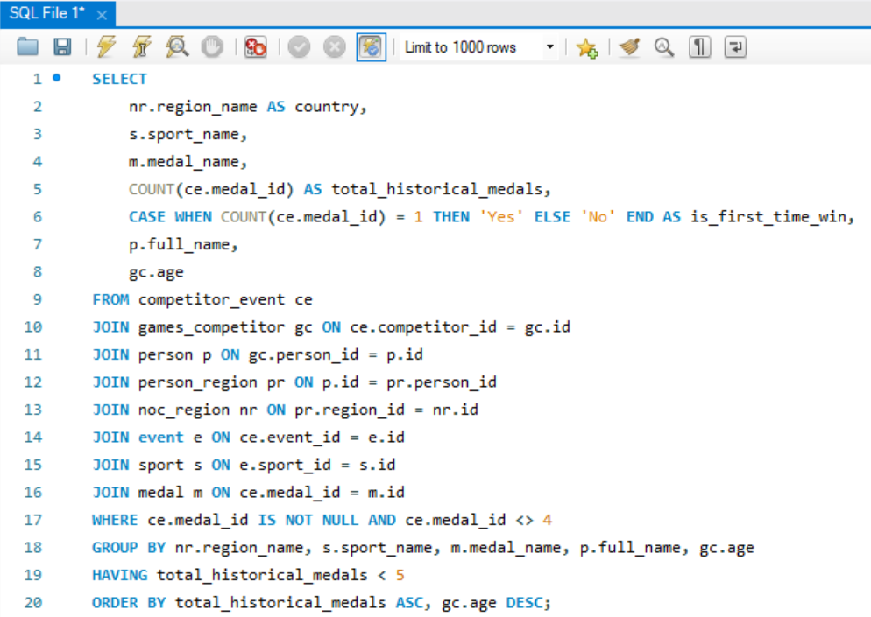

Question: What are some notable instances of unexpected or surprising medal wins?
Age Factor in Unexpected Wins:
The data shows that age is not always a barrier to achieving success, especially in sports that may emphasize skill, strategy, or experience over raw physical strength.
Older athletes securing medals in sports like Art Competitions, Shooting, and Motorboating highlight how experience can play a crucial role.
Emergence of Non-Traditional Sports:
Many of the surprising wins are associated with less mainstream sports like Art Competitions or sports that have seen limited historical participation from certain countries.
This points to evolving interests and investments by countries in diverse sports categories, possibly driven by strategic decisions to expand their medal prospects.
Balanced Success Across Medal Types:
The nearly equal distribution of Gold, Silver, and Bronze medals among first-time wins highlights that unexpected successes are not restricted to just securing a spot on the podium but also include outright victories.
This is particularly significant for smaller countries breaking into new sports, showing that their efforts have led to not just participation but competitive success

Slide 46

Question: Are there any regions that have experienced significant growth or decline in Olympic participation?
Conclusion:
Regions that demonstrated strong growth often maintained that momentum over multiple years, suggesting successful long-term sports programs and consistent support. The sharp declines observed in some cases were typically abrupt, possibly due to sudden socio-economic changes or policy shifts affecting sports funding or participation.
The analysis highlights that while some regions have been able to consistently grow their participation, others have faced challenges leading to significant drops. Understanding these patterns can help stakeholders focus on factors that drive participation, such as government support, economic conditions, and strategic planning for sports development.

Slide 47



Slide 48


